Slide 1

OPERATING SYSTEM FUNCTIONS
Process Scheduling, Memory Allocation and I/O Operations
CSA0408 Technical Presentation
Guided by
Dr.Vasavi J
Presented by
Kavinadhithya R S

Slide 2
1. INTRODUCTION
An Operating System (OS) is system software that manages computer resources.
It acts as a link between the user and computer hardware.
The main functions include process management, memory management and I/O management.
These functions help the computer run programs efficiently and safely.

Slide 3
2. PROCESS MANAGEMENT
A process is a program that is currently running.
The OS creates and terminates processes.
The CPU scheduler decides which process gets CPU time.
Context switching allows the CPU to move between processes.
Example: Running a browser and music player at the same time.

Slide 4
3. MEMORY MANAGEMENT
The OS manages the computer's main memory (RAM).
It allocates memory to processes when they need it.
It releases memory after a process finishes.
It keeps processes from incorrectly accessing another process's memory.
Example: Giving RAM space to a newly opened application.

Slide 5
4. I/O MANAGEMENT
I/O means Input/Output.
The OS controls communication between programs and hardware devices.
Examples include keyboard, mouse, monitor, printer and storage devices.
Device drivers help the OS communicate with specific hardware.
Example: The OS sends print data from an application to a printer.

Slide 6
5. EXAMPLES OF SYSTEM CALLS
fork() – creates a new process.
malloc() – requests memory during program execution.
open() – opens a file.
read() – reads data from a file or device.
write() – writes data to a file or device.
close() – closes an opened file or device.

Slide 7
6. CONCLUSION
The Operating System manages all major computer resources.
Process Management controls CPU execution.
Memory Management controls RAM allocation.
I/O Management controls communication with devices.
System calls provide a way for programs to request OS services.
These functions work together to make the computer reliable and efficient.

Slide 8
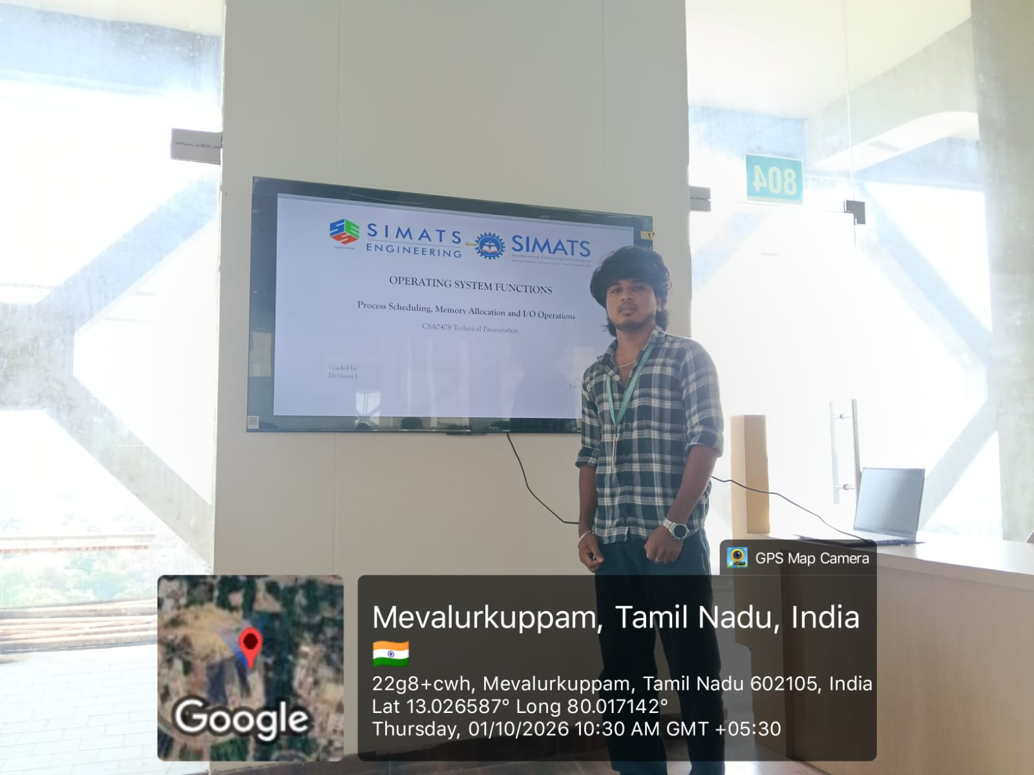

Slide 9


